Slide 1
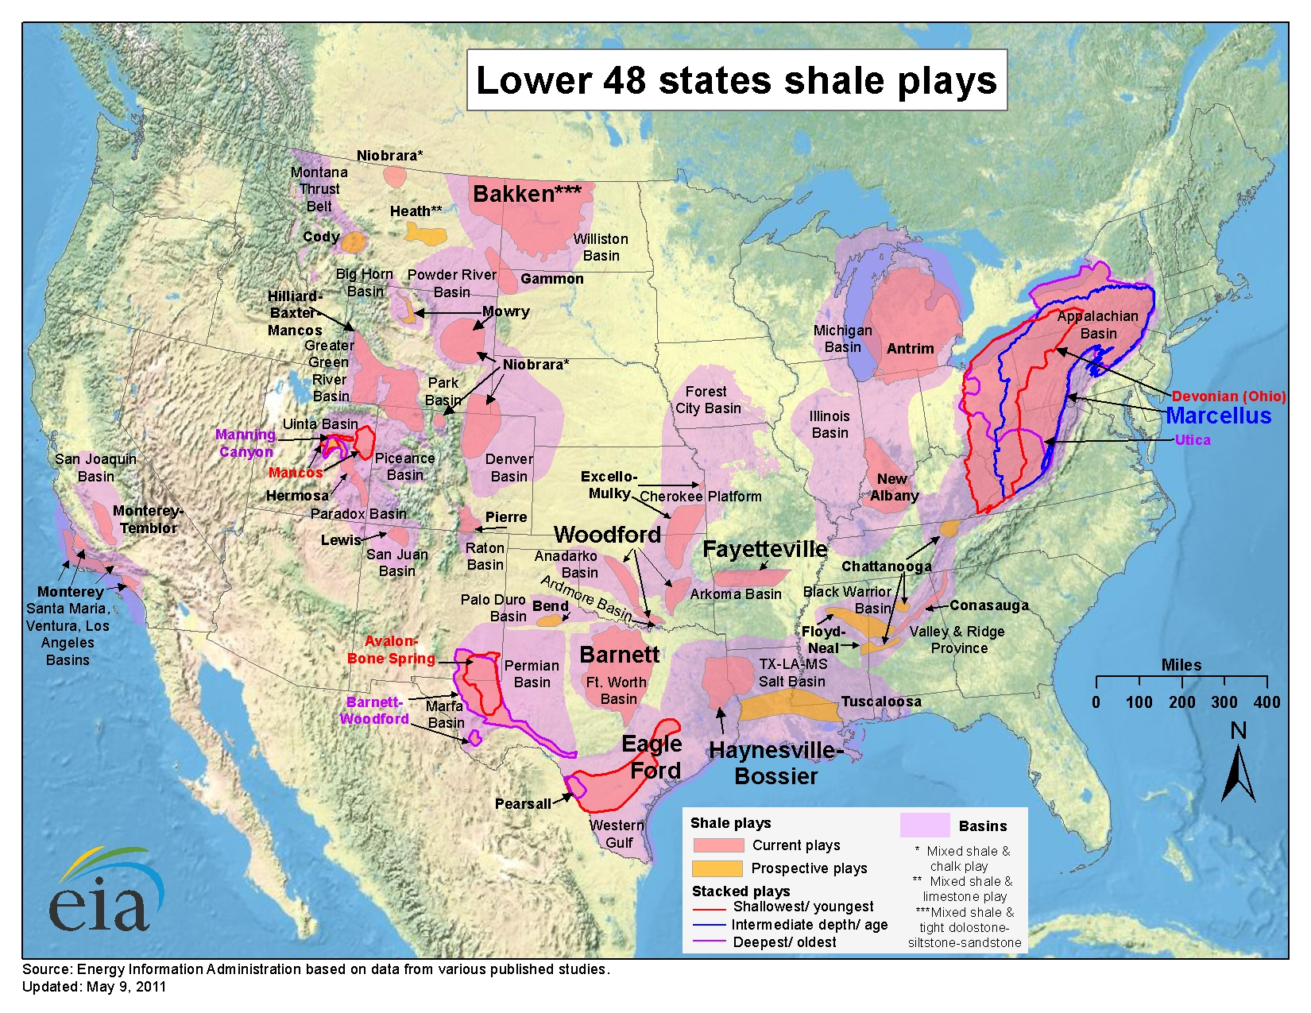
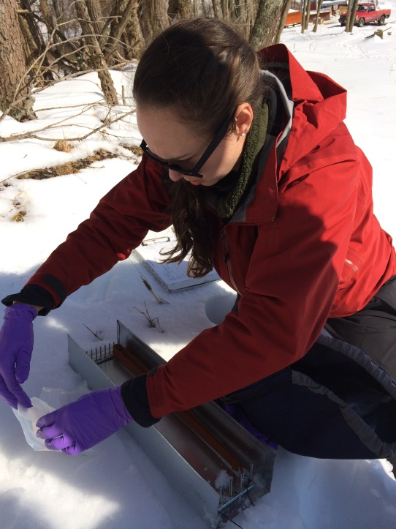
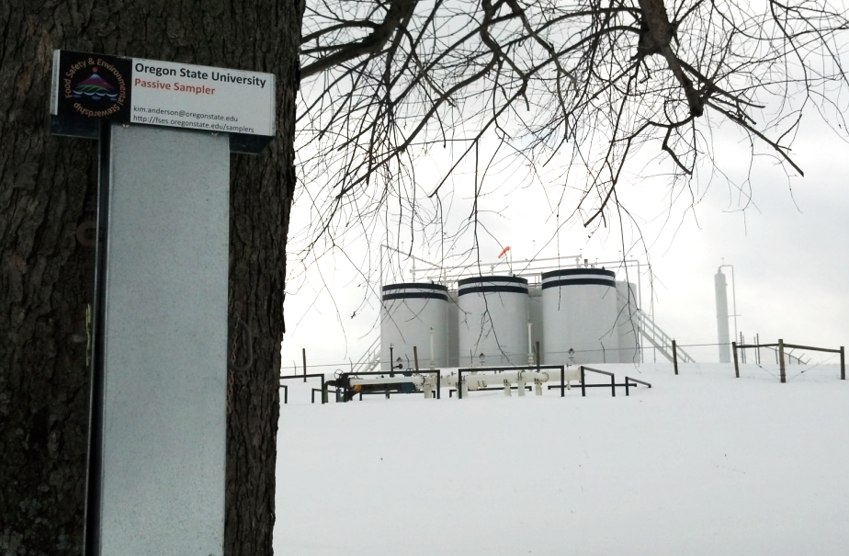
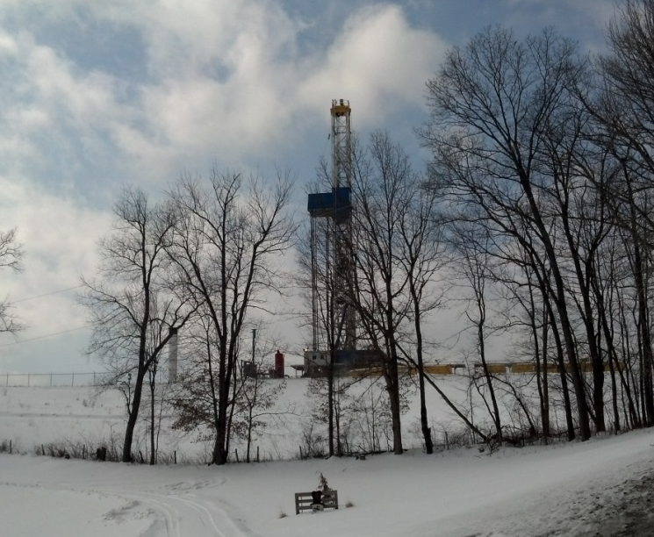
Impact of fracking on PAH levels in ambient air
L. Blair Paulikª, Carey E. Donaldª, Brian W. Smithª, Lane G. Tidwellª, Kevin A. Hobbieª, Laurel Kincl^{b}, Erin N. Haynes^{c}, Kim A. Andersonª
ªDepartment of Environmental and Molecular Toxicology, Oregon State University, Corvallis, Oregon, USA; ^{b}College of Public Health and Human Sciences, Oregon State University, Corvallis, Oregon, USA; ^{c}Department of Environmental Health, University of Cincinnati, Cincinnati, Ohio, USA
Introduction
Fracking is increasing rapidly in the United States (Figure 1)
Studies suggest exposure to fracking-related volatile organic compounds are associated with health risks^{2,3}
Polycyclic aromatic hydrocarbons (PAHs) may be of concern⁴⁻⁶
Only one study measures ambient PAHs in relation to fracking⁷
Hypothesis
PAH levels increase as distance to an active fracking well decreases
Methods
Deployed low density polyethylene (LDPE) passive air samplers
23 properties, for 3 weeks
Trained landowners mailed to lab at OSU
Cleaned LDPE with isopropanol, extracted with hexane
Analyzed for 62 PAHs using GC-MS/MS
Calculated air concentrations using performance reference compound data⁸
Data grouped based on distance to closest active fracking well (Figure 2)
“Active fracking well” = drilling, drilled, or producing
Two sample t-tests performed on pairwise combinations of distance groups, α = 0.05
Figure 1: Map of natural gas reserves in the United States¹.
Results & Discussion
C.E. Donald deploys passive samplers in air sampling cage (left); an air sampling cage with a producing fracking well pad in the background (right).
.
Distance to active fracking well (miles)
Average sum of 62 PAHs. PAHs show a decreasing trend as distance to the closest active fracking well increases.
Average sum of 14 PAHs, compared to previous studies⁹⁻¹². All data are vapor phase PAHs. PAHs closest to fracking activity are roughly an order of magnitude higher than in rural reference locations.
Fracking well pad
<0.1 mile, “close” (n=5)
0.1-1.0 mile, “middle” (n=12)
>1.0 mile, “far” (n=6)
Distance to active fracking well (miles)
Figure 2: Visual explanation of three distance groups used in data analysis.
PAH sourcing ratios. Petrogenic mixtures are enriched in the more thermodynamically stable isomers, pyrene and phenanthrene. The predominant petrogenic signatures suggest PAH mixtures are predominantly influenced by direct releases of PAHs from the earth, not combustion.
Excess Lifetime Cancer Risk Estimates
3 Exposure Scenarios¹⁴
<0.1 0.1-1 >1.0
Residential maximum
262/million in close group 176/million in far group
Residential minimum
11/million in close group 7/million in far group
Outdoor worker
54/million in close group 36/million in far group
Average carcinogenic potency of PAHs. Benzo[a]pyrene equivalent concentrations (BaP_{eq}), derived using the EPA’s Relative Potency Factors.¹³ Potency decreases significantly when samplers are farthest from fracking activity.
A well is fracked in rural Ohio.
Implications
Sourcing ratios suggest PAHs near fracking wells are influenced by direct releases from the earth
Elevated PAH levels may be related to fracking activity
All excess lifetime cancer risk estimates are >1/million, U.S. EPA’s conservative level of concern
PAH levels are relevant to human health
Acknowledgements
We acknowledge G. Wilson, R. Scott, J. Padilla, G. Points and M. McCartney of the OSU Food Safety and Environmental Stewardship Program for help with analysis, Dr. D. Rohlman of the OSU Environmental Health Sciences Center (EHSC) Community Outreach and Engagement Core (COEC), S. Elam from the University of Cincinnati (UC), EHSC COEC, J. Alden (UC) and Paul Feezel of Carroll Concerned Citizens, all for assistance with volunteer recruitment and communication, P. Kuhnell (UC) for mapping sample sites, and the volunteer participants in Ohio for making this study possible. This work was funded by the National Institute of Environmental Health Sciences grants to UC: P30-ES06096 and OSU: P30-ES000210.
References
¹Energy Institute of America, 2011; ²McKenzie LM, Witter RZ, Newman LS, & Adgate JL (2012) Human health risk assessment of air emissions from development of unconventional natural gas resources. Sci. Total Environ. 424:79-87. ³McKenzie LM, et al. (2014) Birth Outcomes and Maternal Residential Proximity to Natural Gas Development in Rural Colorado. Environmental health perspectives. ⁴Goldstein BD, et al. (2014) The Role of Toxicological Science in Meeting the Challenges and Opportunities of Hydraulic Fracturing. Toxicological Sciences:kfu061. ⁵Adgate JL, Goldstein BD, McKenzie LM (2014) Potential public health hazards, exposures and health effects from unconventional natural gas development. Environmental Science & Technology. ⁶Sommariva R, et al. (2014) Observations of the Release of Non-methane Hydrocarbons from Fractured Shale. Environmental Science & Technology. ⁷Colborn T, Schultz K, Herrick L, & Kwiatkowski C (2014) An Exploratory Study of Air Quality Near Natural Gas Operations. Hum. Ecol. Risk Assess. 20(1):86-105. ⁸Huckins JN, Petty JD, Booij K. (2006) Monitors of Organic Chemicals in the Environment (Springer, New York). ⁹Simcik MF, Zhang H, Eisenreich SJ, Franz TP (1997) Urban Contamination of the Chicago/Coastal Lake Michigan Atmosphere by PCBs and PAHs during AEOLOS. Environmental Science & Technology 31(7):2141-2147. ¹⁰Ravindra K, et al. (2006) Seasonal and site-specific variation in vapour and aerosol phase PAHs over Flanders (Belgium) and their relation with anthropogenic activities. Atmospheric Environment 40(4):771-785. ¹¹Khairy MA & Lohmann R (2012) Field Validation of Polyethylene Passive Air Samplers for Parent and Alkylated PAHs in Alexandria, Egypt. Environmental Science & Technology 46(7):3990-3998. ¹²Tidwell LG, Allan SE, O'Connell SG, Hobbie KA, Smith BW, Anderson KA. (submitted 2014) PAH and OPAH Air-Water Exchange during the Deepwater Horizon Oil Spill. ¹³EPA, U. S. (2010). Development of a Relative Potency Factor (RPF) Approach for Polycyclic Aromatic Hydrocarbon (PAH) Mixtures. Washington, D.C. ¹⁴EPA, U. S. (2014). Memo: Recommended Default Exposure Factors. Office of Solid Waste and Emergency Response. Washington, D.C.

