Slide 1

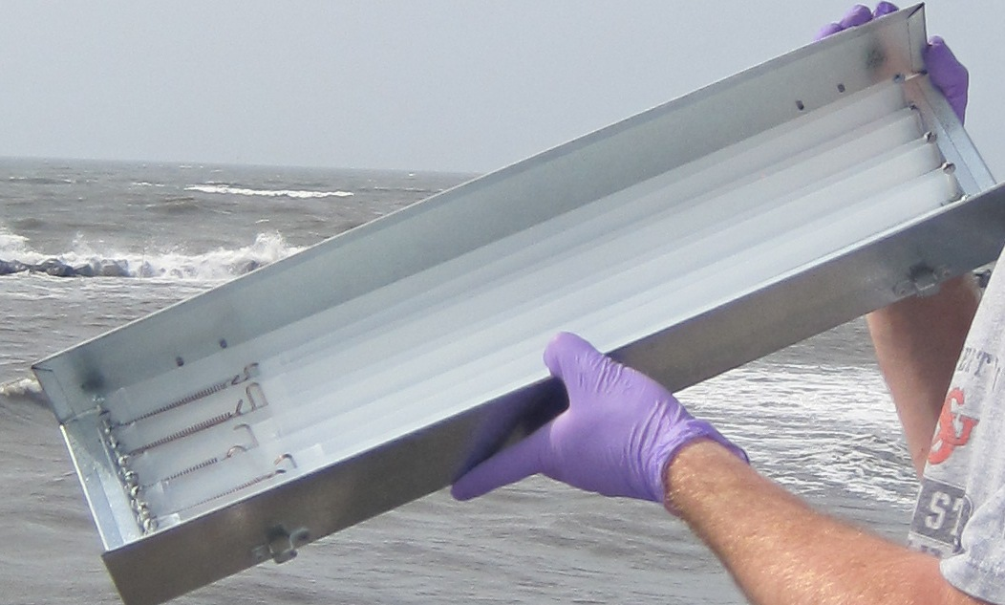
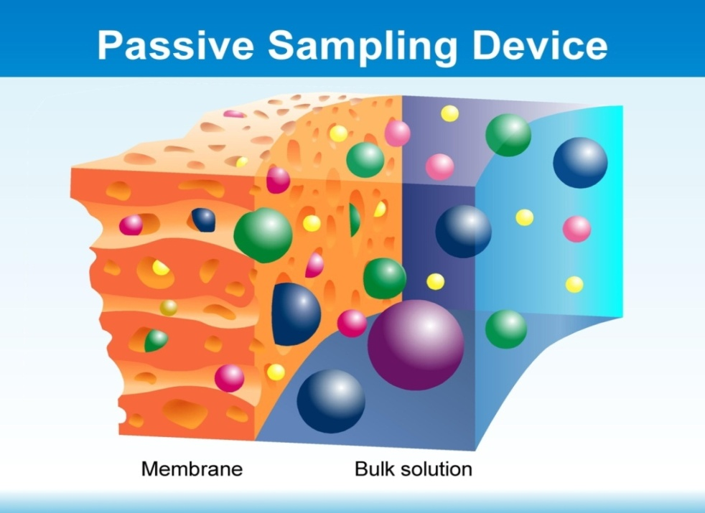
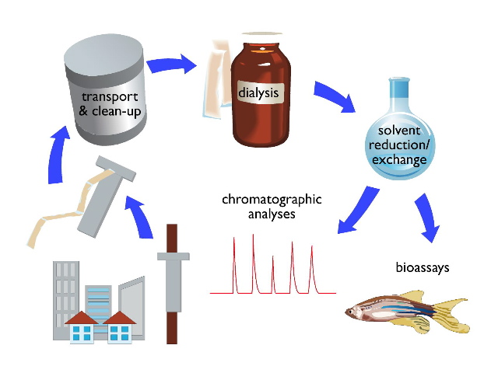
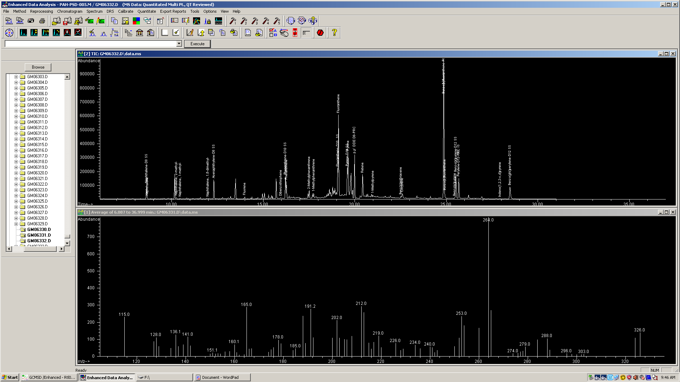
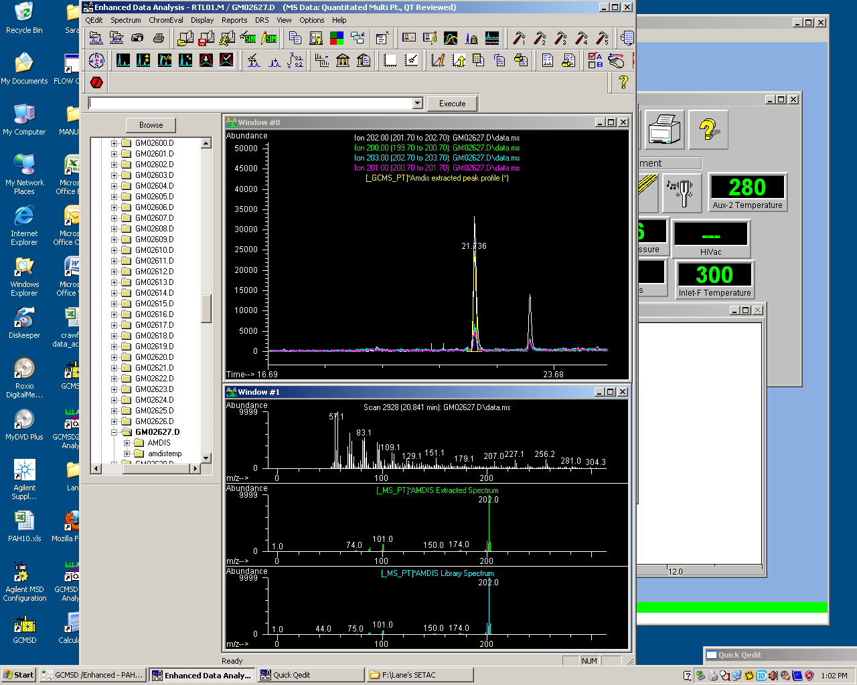
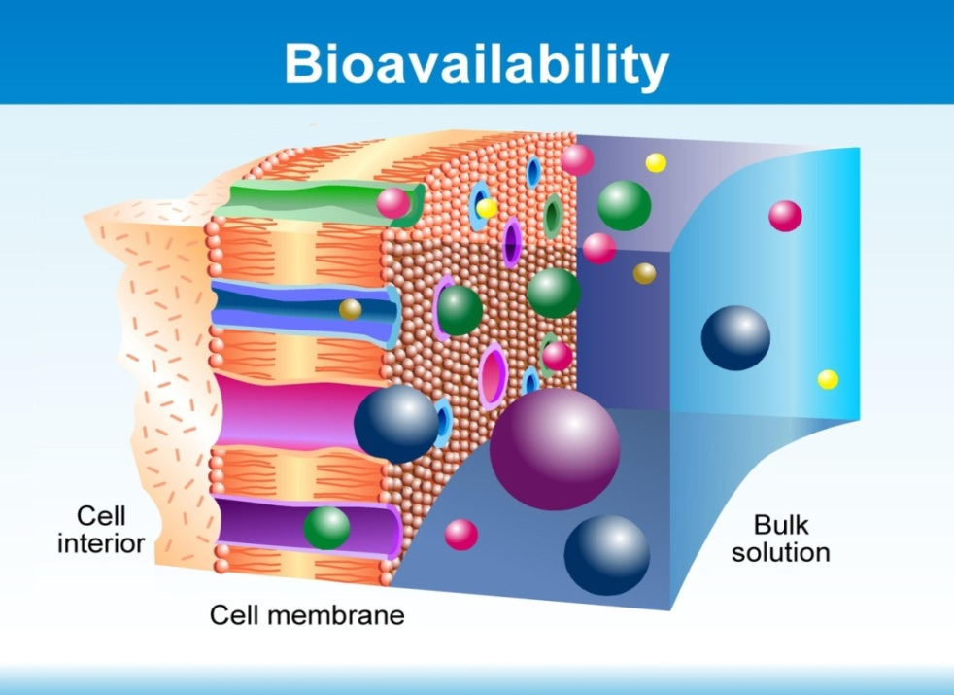
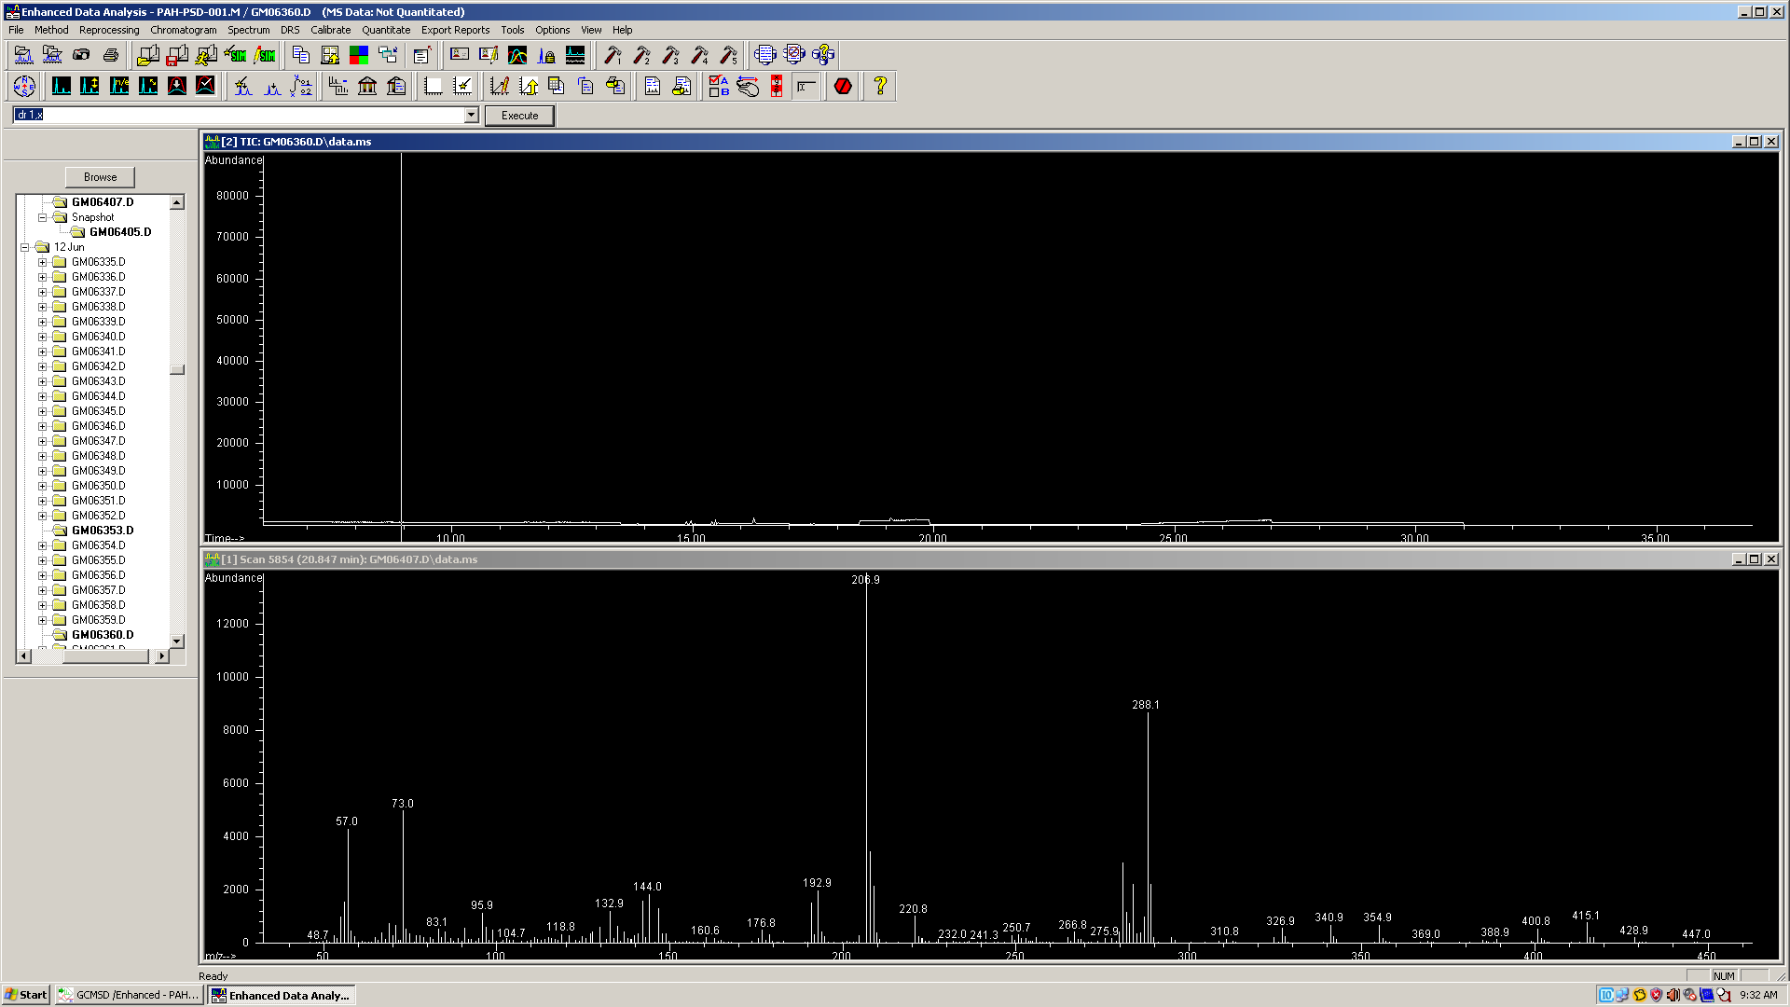
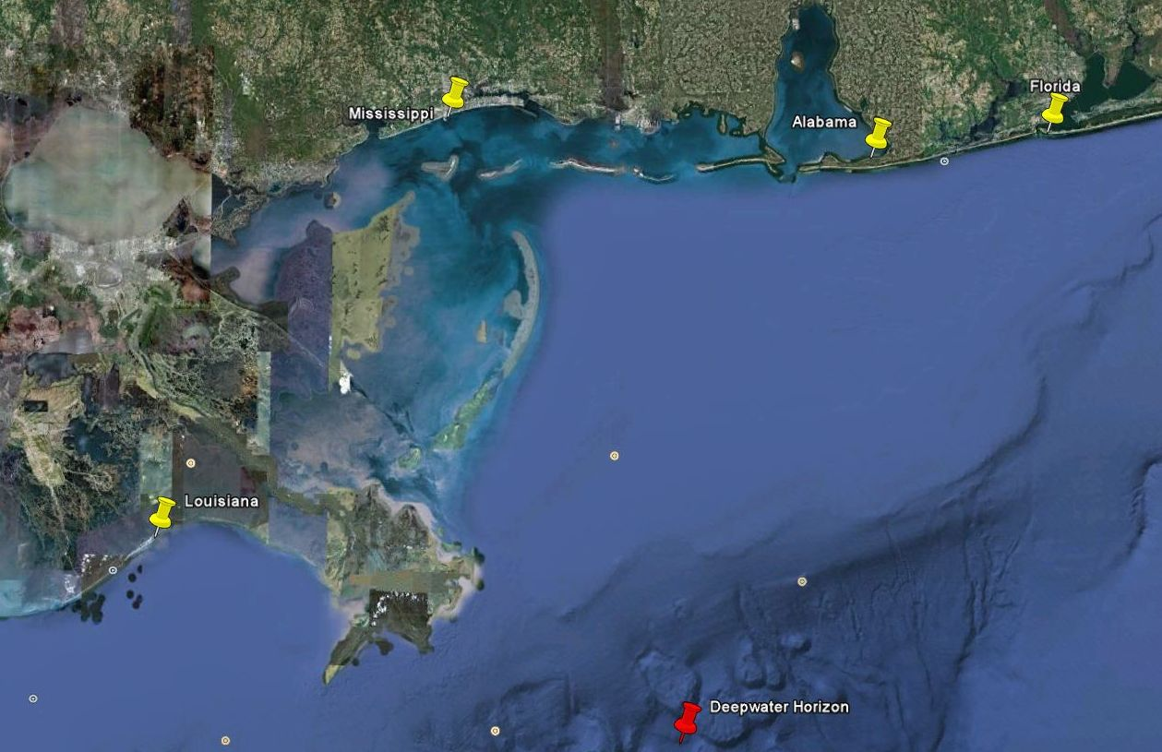
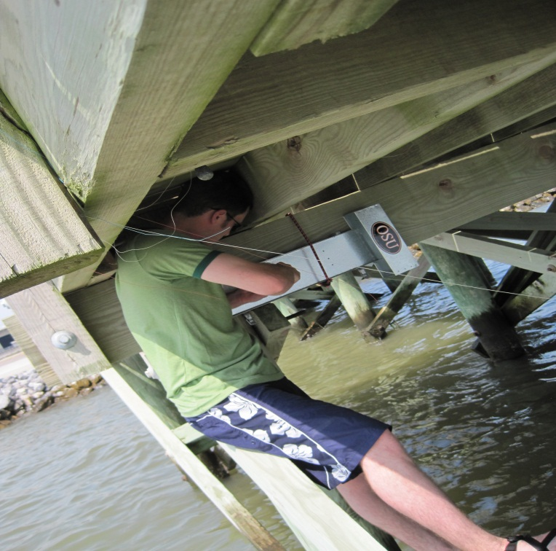
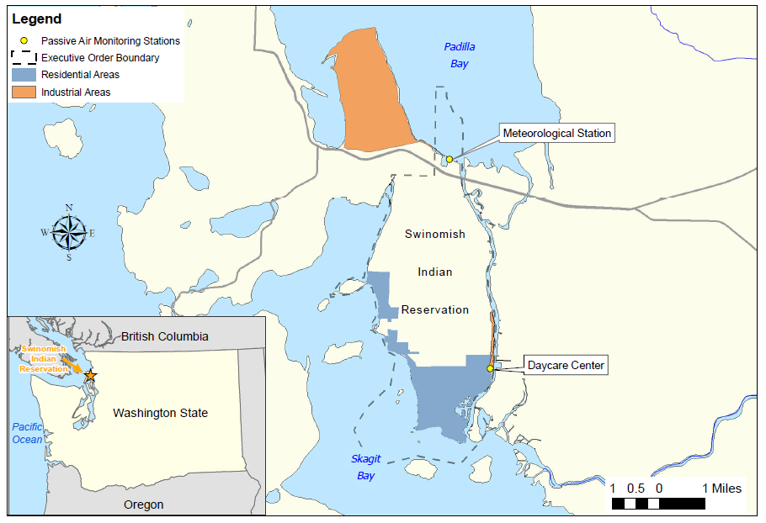
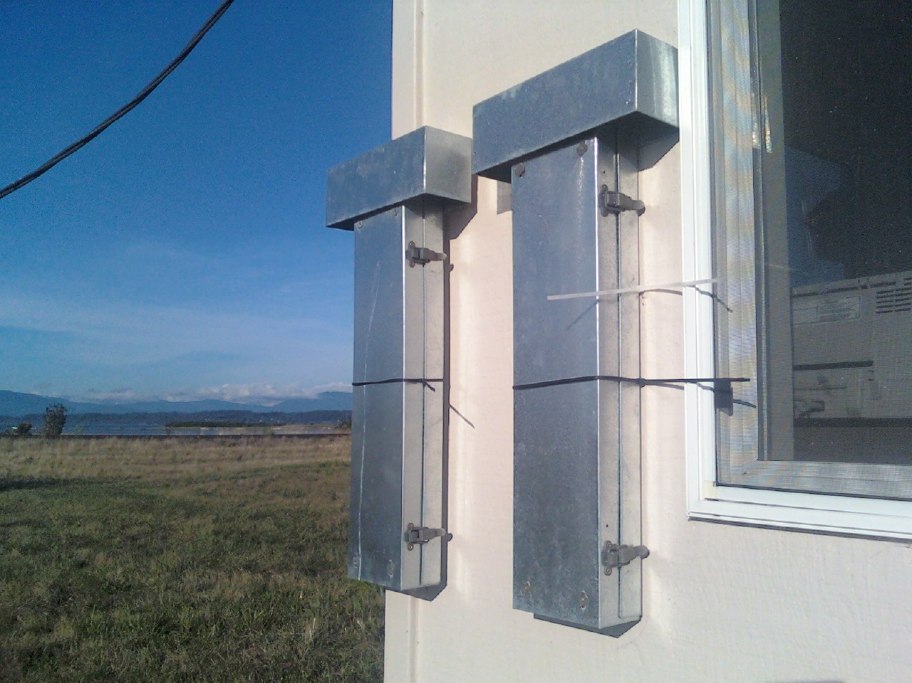
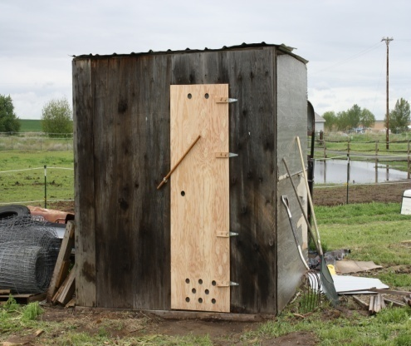


Three Different Demonstration Applications of an Innovative Air Sampling Technology to Address Community-based Environmental Exposures: Oil Spills, Legacy and Emerging Chemicals at Community-Industry Land Boundaries and Introduction of Contaminants during Food Preparation
Lane Tidwell¹, Kevin Hobbie¹, Steven O’Connell¹, Glenn Wilson¹, Jamie Donatuto², Stuart Harris³, Kim A. Anderson¹
Department of Environmental & Molecular Toxicology¹, Oregon State University, Corvallis, Oregon
Office of Planning², Swinomish Indian Tribal Community, La Conner, Washington
Department of Science and Engineering³, Confederated Tribes of the Umatilla Indian Reservation, Pendleton, Oregon
FOOD SAFETY &
ENVIRONMENTAL
STEWARDSHIP
INTRODUCTION:
Although communities often want and need chemical monitoring data to characterize chemicals in their environmental or from their activities, air monitoring equipment is often cost prohibitive or technically impractical. We are further developing air monitoring bio-analytical tools that employ our passive sampling device (PSD). PSDs require no external power, require minimal training for quality controlled sampling, and can be quickly and inexpensively deployed. PSD are capable of providing qualitative and quantitative characterization of exposure to the bioavailable vapor phase fraction of legacy and emerging contaminants in the atmosphere. We demonstrate our PSD’s utility in three vastly different scenarios; before, during and after the Gulf of Mexico Deepwater Horizon oil spill in spring of 2010, at the interface of community tribal lands and high intensity industrial activities, and finally in Native American fish smoking activities. Legacy and emerging PAHs were characterized for all three scenarios; analysis of PSD extracts using a 1,200 analyte screening method was also undertaken. Acute chemical spills generally require a quick response, and often there is a significant, or unknown, exposure prior to elaborate air monitoring equipment setup. We deployed air PSDs prior to, during and after shoreline oiling from the Gulf of Mexico Deepwater Horizon oil spill of 2010 in Louisiana, Mississippi, Alabama and Florida. Emerging and legacy polycyclic aromatic hydrocarbons (PAHs) were quantified in the air PSD. PSDs were also screened for an additional 1,200 contaminants of concern. We demonstrate the utility of the air PSD to respond to acute chemical spills, and to gather chemical data sets on a wide range of contaminants. Communities adjacent to highly industrialized lands often want to understand the contribution of contaminants of concern from industrial activities to their ambient activities. The Swinomish Indian Tribal Community (SITC) offered their lands to further test our developing air PSD technology and to address these kinds of questions. PSD were deployed at SITC, which borders a petroleum facility, continuously for a yearlong study, from these PSD samples legacy and emerging PAHs were identified and quantified. The results indicate spatial and temporal trends that were related to the activities of the tribal community and the petroleum facility. While PSDs have been demonstrated as a surrogate of fish for aquatic environment assessment, atmospheric PSDs have not been previously used as a surrogate of food for preparation technique assessment. Community-based requests often include understanding the effects of special food preparations that are culturally important. The Confederated Tribes of the Umatilla Indian Reservation (CTUIR) requested an assessment of their fish smoking methods. As part of a larger study, we deployed air PSDs during the CTUIR smoking events to further evaluate the utility of using our PSD as a surrogate of smoke-processed fish. In a side-by-side study the PSDs were paired with salmon during smoking. PAHs were quantified from the air PSD and compared with the smoked salmon. The results show excellent promise for an alternative method for assessing food smoking preparation techniques. Throughout these three studies the OSU SRP Research Translation and Community Engagement Cores partnered to develop culturally appropriate messages and data interpretation including workshops, print materials, brochures, and web-based information.
Passive Sampling Device & Deployment Locations
Chromatographic Analysis
Conclusions
LFT extracts analyzed in single ion monitoring mode by Agilent 6890N GC with Agilent 5975B inert XL MSD
Automatic Mass Spectral Deconvolution and Identification System uses retention time indices and mass spectral data to verify compounds in an extract
Passive sampling devices can provide communities impacted by environmental events or industrial activities important information regarding the source and potential exposure to environmental contaminants with benefits of short training time and low cost.
Lipid Free Tubing can be used as a passive sampling device for vapor phase compounds in the atmosphere.
Lipid Free Tubing passive samplers are sensitive enough to reveal spatial and temporal changes in ambient air profiles.
Bulk air
Gulf of Mexico
Bulk air
Total contaminant load in Gulf of Mexico air was highest in Mississippi.
Air contaminant load in Alabama and Florida did not exceed background levels.
Sampling periods that revealed high levels of PAHs in Gulf of Mexico air could be attributed to cleanup efforts as well as crude oil, profile sourcing work is ongoing.
Lipid Free Tubing passive samplers are robust and sensitive enough to withstand deployment times between 4 to 126 days.
Top: Example of exposed LFT
Example of AMDIS extracted flouranthene in exposed LFT extract from Louisiana
Gulf of Mexico locations:
Fort Pickens, FL
Bon Secour, Al
Gulfport, MS
Grand isle, LA
Research permits were obtained for all study sites.
Bottom: Example of non-exposed LFT
Our AMDIS library contains more than 1,200 compounds including: 926 Pesticides and Endocrine Disruptors, 209 PCBs, 66 Parent and substituted PAHs
Our SIM method is composed of 33 legacy and emerging PAHs.
Gulf of Mexico Results
SITC
Total PAH air concentration on tribal lands was highest at the site that bordered the oil refinery.
Spatial and temporal differences between the two sampling sites may help to further
Round robin style collaborative studies using passive sampling devices can be successfully completed as long as appropriate training and QA/QC procedures are in place.
Compounds positively identified using the screening method included: 6 oxygenated PAHs, 1 nitrogenated PAH, 23 PAHs, 1 sulfonated PAH, 12 pesticides, and multiple industrial compounds.
SITC sampling locations:
Meteorological station at northern end of tribal land near a petroleum refining facility
Southern region of tribal lands close to high use industrial area
MDSA obtained prior to study
SITC Results
CTUIR Results
CTUIR sampling locations:
PSDs and salmon smoked in two structures with two wood types
MDSA obtained prior to study
REFERENCES:
Anderson, K. A.; Sethajintanin, D.; Sower, G.; Quarles, L., Field Trial and Modeling of Uptake Rates of In Situ Lipid-Free Polyethylene Membrane Passive Sampler. Environmental Science & Technology 2008, 42, (12), 4486-4493.
Peter, D. A.; Mallard, W. G., Automated Mass Spectral Deconvolution & Identification System - User Guide. U.S. Dept of Commerce. National Institute of Standards and Technology: Gaithersburg, MD, 2004.
3 Hillwalker, W.E., et al. Exploiting lipid-free tubing passive samplers and embryonic zebrafish to link site specific contaminant
mixtures to biological responses. Chemosphere (2010), doi:10.1016/j.chemosphere.2010.02.001
ACKNOWLEDGEMENTS:
Compounds positively identified using the screening method included: 4 oxygenated PAHs, 22 PAHs and 2 industrial compounds
Oregon State University Food Safety & Environmental Stewardship Program Laboratory Staff, Dr. Joe Beckman and Environmental Health Sciences Center, funded by NIEHS grant #P30 ES00210. Support from OSU Superfund Research Program funded by NIEHS grant #P42 ES016465.

Slide 2

Although communities often want and need chemical monitoring data to characterize chemicals in their environmental or from their activities, air monitoring equipment is often cost prohibitive or technically impractical. We are further developing air monitoring bio-analytical tools that employ our passive sampling device (PSD). PSDs require no external power, require minimal training for quality controlled sampling, and can be quickly and inexpensively deployed. PSD are capable of providing qualitative and quantitative characterization of exposure to the bioavailable vapor phase fraction of legacy and emerging contaminants in the atmosphere. We demonstrate our PSD’s utility in three vastly different scenarios; before, during and after the Gulf of Mexico Deepwater Horizon oil spill in spring of 2010, at the interface of community tribal lands and high intensity industrial activities, and finally in Native American fish smoking activities. Legacy and emerging PAHs were characterized for all three scenarios; analysis of PSD extracts using a 1,200 analyte screening method was also undertaken.
Acute chemical spills generally require a quick response, and often there is a significant, or unknown, exposure prior to elaborate air monitoring equipment setup. We deployed air PSDs prior to, during and after shoreline oiling from the Gulf of Mexico Deepwater Horizon oil spill of 2010 in Louisiana, Mississippi, Alabama and Florida. Emerging and legacy polycyclic aromatic hydrocarbons (PAHs) were quantified in the air PSD. PSDs were also screened for an additional 1,200 contaminants of concern. We demonstrate the utility of the air PSD to respond to acute chemical spills, and to gather chemical data sets on a wide range of contaminants.
Communities adjacent to highly industrialized lands often want to understand the contribution of contaminants of concern from industrial activities to their ambient activities. The Swinomish Indian Tribal Community (SITC) offered their lands to further test our developing air PSD technology and to address these kinds of questions. PSD were deployed at SITC, which borders a petroleum facility, continuously for a yearlong study, from these PSD samples legacy and emerging PAHs were identified and quantified. The results indicate spatial and temporal trends that were related to the activities of the tribal community and the petroleum facility.
While PSDs have been demonstrated as a surrogate of fish for aquatic environment assessment, atmospheric PSDs have not been previously used as a surrogate of food for preparation technique assessment. Community-based requests often include understanding the effects of special food preparations that are culturally important. The Confederated Tribes of the Umatilla Indian Reservation (CTUIR) requested an assessment of their fish smoking methods. As part of a larger study, we deployed air PSDs during the CTUIR smoking events to further evaluate the utility of using our PSD as a surrogate of smoke-processed fish. In a side-by-side study the PSDs were paired with salmon during smoking. PAHs were quantified from the air PSD and compared with the smoked salmon. The results show excellent promise for an alternative method for assessing food smoking preparation techniques. Throughout these three studies the OSU SRP Research Translation and Community Engagement Cores partnered to develop culturally appropriate messages and data interpretation including workshops, print materials, brochures, and web-based information.
Sampling Method:
Spiked and blank Lipid-free Tubing (LFT) samplers were deployed in the Gulf of Mexico at four sites in four states in air for 3 to 35 days.
Performance reference compounds in spiked samplers were used to calculate contaminant uptake rates.
  Surrogates were used during extraction to account for potential losses
  Analyzed by GC-MS utilizing retention time locking and Agilent DRS software and compared against combined libraries totaling over 1,200 known chemicals of concern
Blank extracts
  Exchanged to dimethyl sulfoxide (DMSO) for embryonic zebrafish exposure
Lipid Free Tubing
Low-density polyethylene
Wall thickness of ca. 75-95 μm
Dimensions: 2.5 x 100 cm
Transient cavities of ~10 Å by thermal motion
Biomembrane pores estimated at 9.8 Å
Sequesters bioavailable organic contaminants
LFT in deployment cage

